Slide 1
Market Structure

Slide 2
MARKET STRUCTURE
Refers to the types of market in which the firms/producers/sellers operate

Slide 3
Important features of the market structure
Number of buyers and sellers including their relative strength
Market share of the largest firms
Degree of freedom to determine the price
Level and forms of competition
Nature of costs (including the potential of firms to exploit economies of scale and also the presence of sunk costs)
Degree to which the industry is vertically integrated
Vertical integration explains the process by which different stages in production and distribution of a product are under the ownership and control of a single enterprise.

Slide 4
Extent of product differentiation (affects cross-price elasticity of demand)
ease of entry into and exit from the market
Structure of buyers in the industry (including the possibility of monopsony power)
Turnover of customers
How many customers are prepared to switch their suppliers when market conditions change.
Affected by the degree of consumer or brand loyalty and the influence of persuasive advertising and marketing

Slide 5
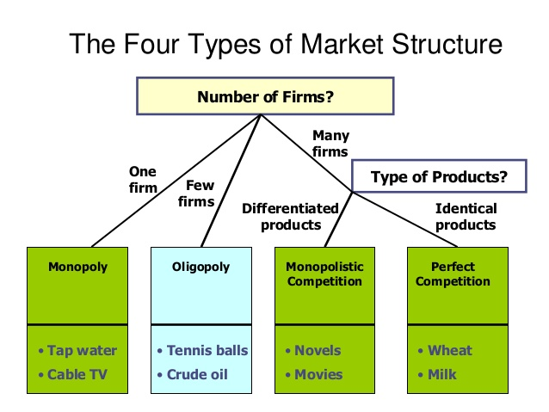

Slide 6
PERFECT COMPETITION
Large numbers of buyers and sellers of homogeneous products
Complete absence of rivalry among the firms/producers
Potatoes are sold in markets where all vendors sell homogenous products at homogeneous prices.

Slide 7
Basic Characteristics of Perfect Competition:
Large number of buyers and sellers
Product homogeneity
Free entry and exit
Perfect knowledge about the market
Perfect mobility of factors and products

Slide 8
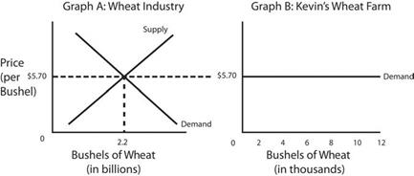
For a firm, AR=MR=Price

Slide 9
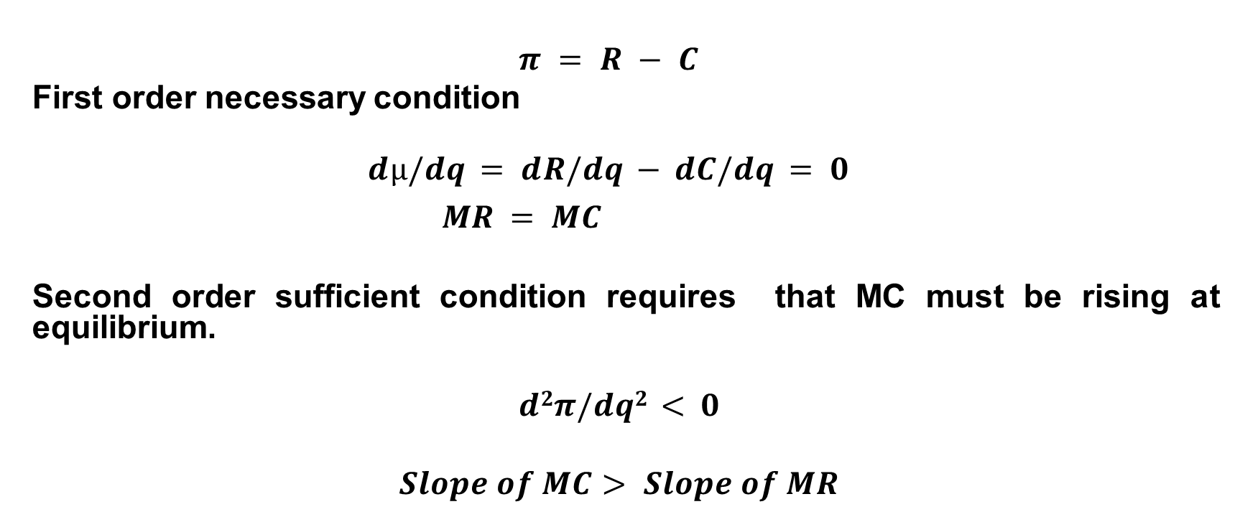
Equilibrium Conditions
$$π = R − C$$
First order necessary condition
$$dµ/dq = dR/dq − dC/dq = 0$$
$MR = MC$
Second order sufficient condition requires that MC must be rising at equilibrium.
$$d2π/dq2 < 0$$
$$Slope of MC> Slope of MR$$

Slide 10
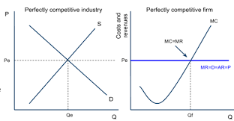
Firm’s Equilibrium

Slide 11
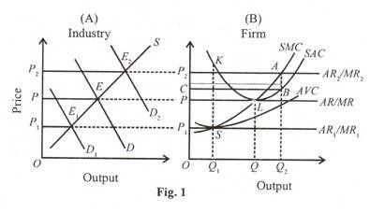
Short-run Equilibrium

Slide 12
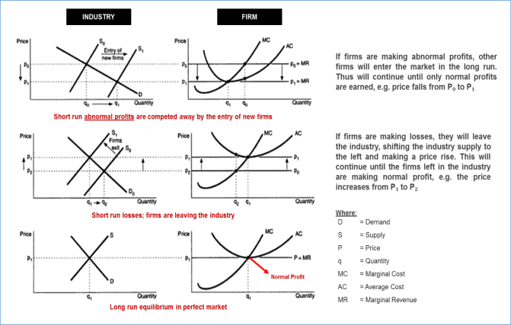
Long-run Equilibrium

Slide 13
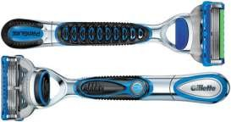
MONOPOLY: Characteristics
Only one producer/seller for a product
Restricted entry
No close substitutes
Gillette- Razor blade
• Gillette is a razor blade that enjoys monopoly in
market because every consumer purchases this brand
and this is a trusted brand.

Slide 14
Factors responsible for the existence of Monopoly
Ownership over strategic raw materials
Patent right
Natural monopoly (Economies of large scale production)
Limit pricing policy

Slide 15
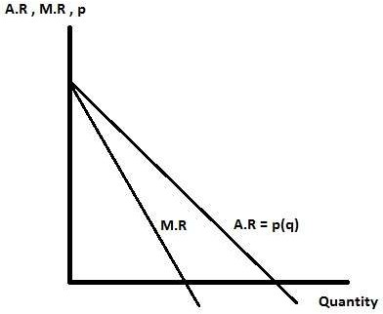
Demand curve for a monopoly firm
Because the monopoly firm is a price maker, it faces a downward sloping demand curve. It has to accept lower price for selling more output.

Slide 16
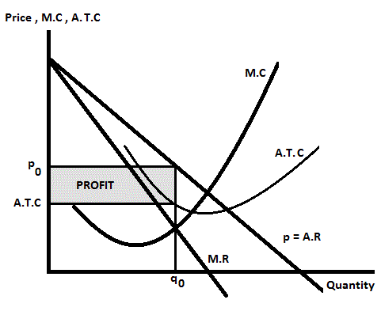
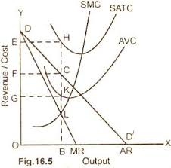
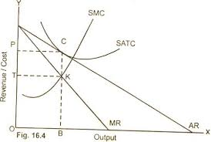
Equilibrium conditions under Monopoly
MC = MR
Slope of MC > Slope of MR
Short-run Situations

Slide 17
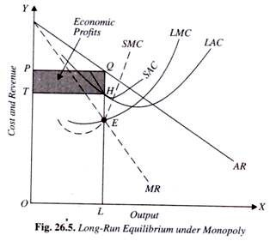
Long-run Situations

Slide 18
Perfect competition vs Monopoly

Slide 19
Monopoly and Perfect Competition represent two extremes along a continuum of market structures. At the one extreme is Perfect Competition, representing the ultimate of efficiency achieved by an industry that has extensive competition and no market control. Monopoly, at the other extreme, represents the ultimate of inefficiency brought about by the total lack of competition and extensive market control.
Monopoly is a market structure in which there is a single supplier of a product. It is a market structure in which a single firm makes up the entire market. So it has the capability to influence and determine the market price. There are barriers in monopoly which prevent the entry of other suppliers in that monopolistic market.
Perfect competition is a market in which many firms sell identical products to many buyers. A firm is a price taker i.e. it cannot influence the price of a good or service. No single firm can influence the price. It must “take” the equilibrium market price. There are no restrictions to entry and exit into the industry. Sellers and buyers are well informed about prices. The product is homogeneous. The established firms have no advantages over new ones.

Slide 20
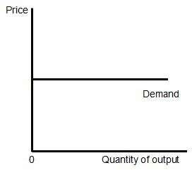
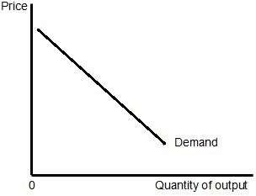
Perfect Competition | Monopoly
Production and pricing decisions : A large number of firms Price taker Many producers of the same product Fig : Perfect Competition Demand Curve Because they are Price Takers, they face a horizontal demand curve. | Production and pricing decisions : One firm is present. Price maker Only producer of the product Fig : Monopoly Demand Curve Because they are the Price Maker, they face a downward sloping demand curve. They have to accept lower price for selling more output.

Slide 21
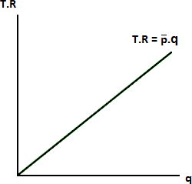
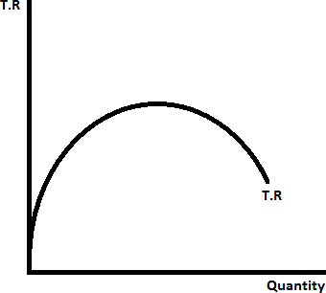
In case of Perfect Competition :
In case of Monopoly :
Total Revenue (T.R) = 𝒑.q
Where, 𝒑 is the fixed price and q is quantity
Total Revenue (T.R) = p(q) . q
where, p(q) shows that price (p) is a function
of quantity (q)
Fig : Total Revenue Curve
A monopolist firm sets the price of the product. So, Marginal Revenue :
Fig : Total Revenue Curve
A perfect competitor accepts the market
𝑑𝑅 𝑑
(𝑝. 𝑞)
M.R = =
𝑑𝑞 𝑑𝑞
𝑑𝑞
𝑑𝑞
𝑑𝑝
𝑑𝑞
= p .
+ q .
𝑑𝑝
𝑑𝑞
= p + q .
price as given. As a result,
Revenue equals price. Marginal Revenue (M.R) = 𝒑
= p (1 +
𝑞 𝑑𝑝
. )
Marginal
𝑝 𝑑𝑞
= p (1 +
1
𝑑𝑞 𝑝 ⁾
.
𝑑𝑝 𝑞
1
= p (1 − )
𝑒
𝑑𝑞 𝑝
where e is elasticity given by ; e =
.
𝑑𝑝 𝑞

Slide 22
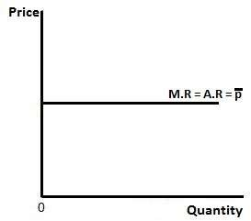
We know that, Average Revenue (A.R) = T.R ÷ q = ( 𝒑.q) ÷ q = 𝒑 So, A.R = M.R = 𝒑 Fig : Curve showing Average revenue, Marginal Revenue and Price | We know that, Average Revenue (A.R) = T.R ÷ q = (p . q) ÷ q = p = p(q) because p is a function of q So, A.R = p(q) > M.R Fig : Curve showing Average revenue, Marginal Revenue and Price
Short Run Equilibrium of Perfect Competition : In short run, number of firms in industry is fixed. Law of One Price implies that at a given price firms will supply a certain quantity of output. Objecti ve of any firm is profit maximization. Short-run profit is total revenue minus short-run total cost i.e. π = TR –TC | Short Run Equilibrium of Monopoly : Monopolist can change the price for his product. The firm attempts to maximize its profit .Monopolist can fix the price as well as quantity output to be sold in the market to get maximum revenue from his sales proceeds. But it cannot decide both simultaneously. Short-Run Profit, i.e π = TR – TC = (Price – A.T.C) × Quantity

Slide 23
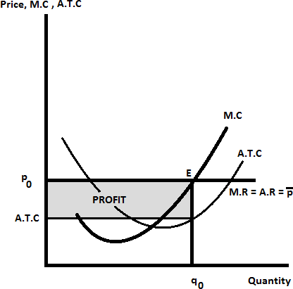
Marginal Cost (MC) must be rising. Fig : Curve showing Price, Marginal Cost, and Average Total Cost | Here ATC is Average Total Cost and TC is Total Cost Fig : Curve showing Price, Marginal Cost, and Average Total Cost
Short Run Equilibrium condition of Perfect Competition : First Order Condition is dπ/dq = dTR/dq - ∂STC/∂q = 0 MR – SMC = 0 dTR/dq is Marginal Revenue, M.R ∂STC/∂q = SMC Here price is fixed i.e. MR= P= MC Second Order Condition requires that MC must be rising at equilibrium. | Short Run Equilibrium condition of Perfect Competition : First Order Condition is dπ/ dq = dTR/dq - ∂TC/∂q = 0 MR – MC = 0 dTR/dq is Marginal Revenue, M.R ∂TC/∂q = MC MR = MC < p Second Order Condition : d²π/dq² = dMR/dq – dMC/dq < 0

Slide 24
Characteristics | Perfect Competition | Monopoly
Number of sellers | Many (price takers) | One (price maker)
Substitution of Product sold | Only one product type from all sellers | No Substitutes
Barriers to entry into the market | No barriers to entry or exit | Almost impossible for others to enter the market
Pricing vs MC and MR | P=MC=MR | P > MR , P > MC
Profit | Efficient with zero economic profit P = ATC in the long run | P > ATC Big LR profits (Supernormal profit)

Slide 25
MONOPOLISTIC COMPETITION
Large numbers of firms
Products are differentiated but close substitutes (such as branding, quality, or location).
Fancied differences rather than real
A firm takes the prices charged by its rivals as given and ignores the impact of its own prices on the prices of other firms.
Consumers may like some special things in a particular brand.

Slide 26
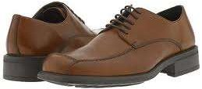
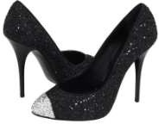
MONOPOLISTIC COMPETITION
Shoes
Shoes are produced by many producers but consumers may feel that a particular company is branded or the quality produced by one company is better than the other.
Different company’s shoes can be easily differentiated and despite differentiation each product remains close substitute for the rival product.

Slide 27
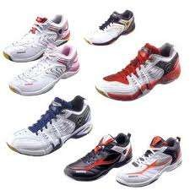
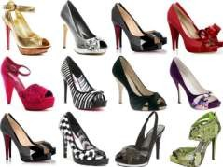
MONOPOLISTIC COMPETITION
There is no pure competition
Shoes come under monopolistic competition because there are many producers and consumers choose according to the brand, quality, location, trademark, design, colour, packaging, etc. and not on the basis of price only.

Slide 28
Oligopoly
Few Firms
Identical products (Pure oligopoly)/Close substitute products (Differentiated oligopoly)
Collusive oligopoly/Non-collusive oligopoly
Price/output competition

Slide 29
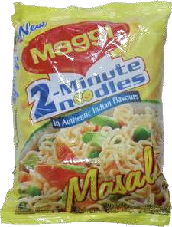
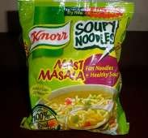
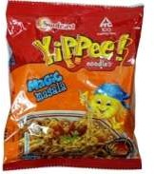
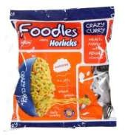
OLIGOPOLY
Maggi noodles, Sunfeast yippee magic noodles, Horlicks foodles, Knorr soupy noodles.
These companies produce instant noodles.
Earlier Maggi used to enjoy monopoly in this sector but with the entry of the other three companies Maggi now comes under oligopoly.
These four companies majorly rule the market in instant noodles.

Slide 30

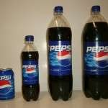
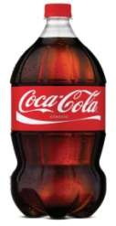

DUOPOLY
Pepsi and Coca-Cola in •
soft drinks
In the market of soft drinks, Pepsi and Coca-Cola rule. So they come under Duopoly.
Other soft drinks are also there but these two companies cover large share in soft drinks market.

